Slide 1
Hospital Management System
By Naga Satya Sai Pavirala

Slide 2
Tools Used:
1.Spring boot framework for easy development
2.Maven build tool for building the project
3.Github for version control system of code created
4.Swagger UI for graphical user interface
5.Postman tool to handle get and post requests
6.Mongo db(no sql) database to store data
7.S3 Studio for interacting with database in graphical user interface
7.Junit for testing the code
8.Docker Desktop for deploying the images into container and for running the images

Slide 3
List of dependencies added in POM.xml:
spring-boot-starter-web
spring-boot-starter-test
spring-boot-starter-security
spring-security-test
springdoc-openapi-ui
commons-io
Junit
spring-boot-starter-data-mongodb

Slide 4
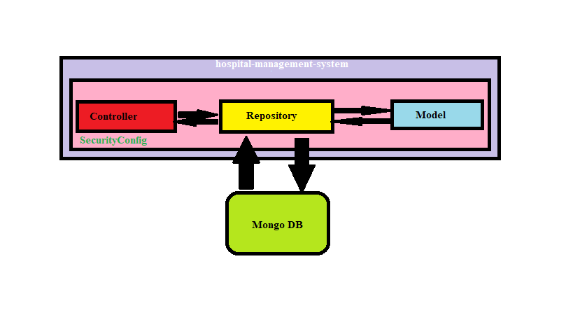
Architecture:

Slide 5
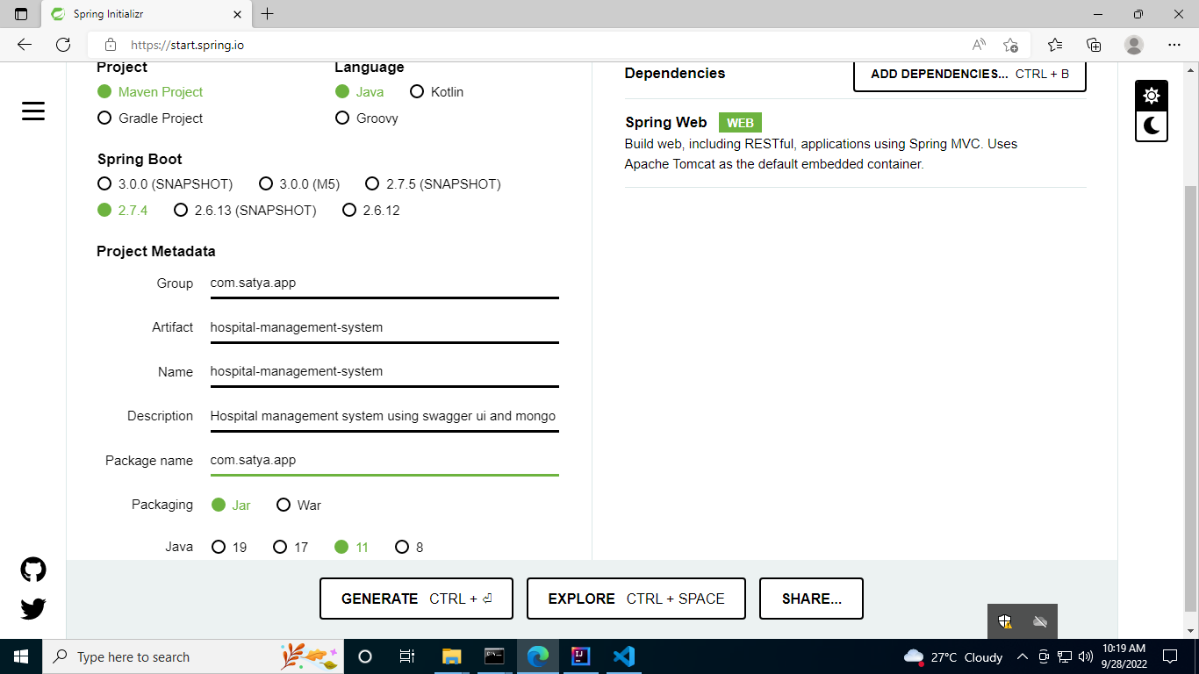
Creation of Project:

Slide 6
MVC Files used in system:
1.Controllers:
a.Doctor
b.Patient
c.Prescription
2.Data model
a.Appointment
b.Prescription
3.Repository
a.Appointment repository
b.Prescription repository

Slide 7
Data Model Attributes:
a) Appointment Data Model:
String appointmentId;
String patientName;
String doctorName;
String date;
Prescription prescription;

Slide 8
Data Model Attributes:
b)Prescription Data Model :
String prescriptionId;
String appointmentId;
String description;
String patientName;
String doctorName;

Slide 9
Doctor Controller:
“/save” – This will send POST requests along with Appointment object in JSON format as body.
Ex – “http://localhost:8081/doctor/save” .
{
"appointmentId":"appointment1",
"patientName":"patient1",
"doctorName":"doctor1",
"date":"29/09/2022",
"prescription":{
"prescriptionId":"prescription1",
"appointmentId":"appointment1",
"description":"description1",
"patientName":"patient1",
"doctorName":"doctor1"
}
}
“/doctorappointment” - This will receive GET requests along
with request parameters.
Ex-”http://localhost:8081/doctor/doctorappointment?doctorNa me=doctor1”.

Slide 10
Patient Controller:
“/save” – This will send POST requests along with Appointment object in JSON format as body.
Ex – “http://localhost:8081/patient/save” .
{
"appointmentId":"appointment1",
"patientName":"patient1",
"doctorName":"doctor1",
"date":"29/09/2022",
"prescription":{
"prescriptionId":"prescription1",
"appointmentId":"appointment1",
"description":"description1",
"patientName":"patient1",
"doctorName":"doctor1"
}
}
“/myappointment” – This will receive GET requests along with request parameters.
Ex-”http://localhost:8081/patient/patientappointment?patie ntName=patient1”.

Slide 11
PrescriptionController:
“/saveprescription” – This will send POST requests along with Prescription object in JSON format as body.
Ex – “http://localhost:8081/saveprescription” .
{
"prescriptionId":"prescription1",
"appointmentId":"appointment1",
"description":"prescription1",
"patientName":"patient1",
"doctorName":"doctor1"
}
“/viewprescription” - which will receive GET requests along with request parameters.
Ex-”http://localhost:8081/saveprescription?patientName= patient1”.

Slide 12
Security access role based:
Security is maintained by using security config file and access to controllers were allowed by using the following usernames and passwords.
“ /swagger-ui/index.html” - Username:admin01 Password:password
“ /doctor/doctorappointment” - Username:doctor01 Password:password
“/doctor/save“ - Username:doctor01 Password:password
“/patient/myappointment“ - Username:patient01 Password:password
“/patient/save” - Username:patient01 Password:password
“/viewprescrption“ - Username:admin01 Password:password
“/saveprescrption” - Username:admin01 Password:password

Slide 13
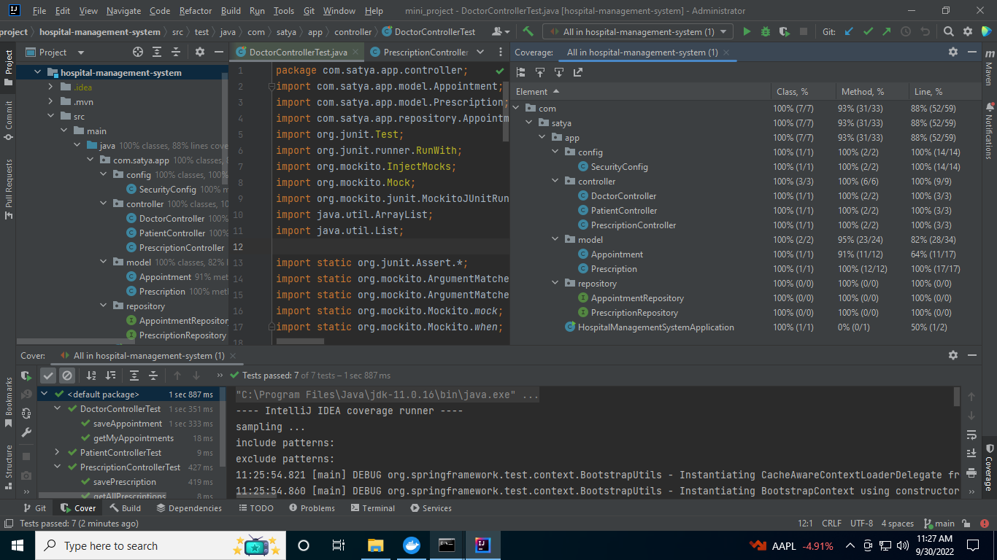
Code Coverage:
Class:100%
Method:93%
Line:88%

Slide 14
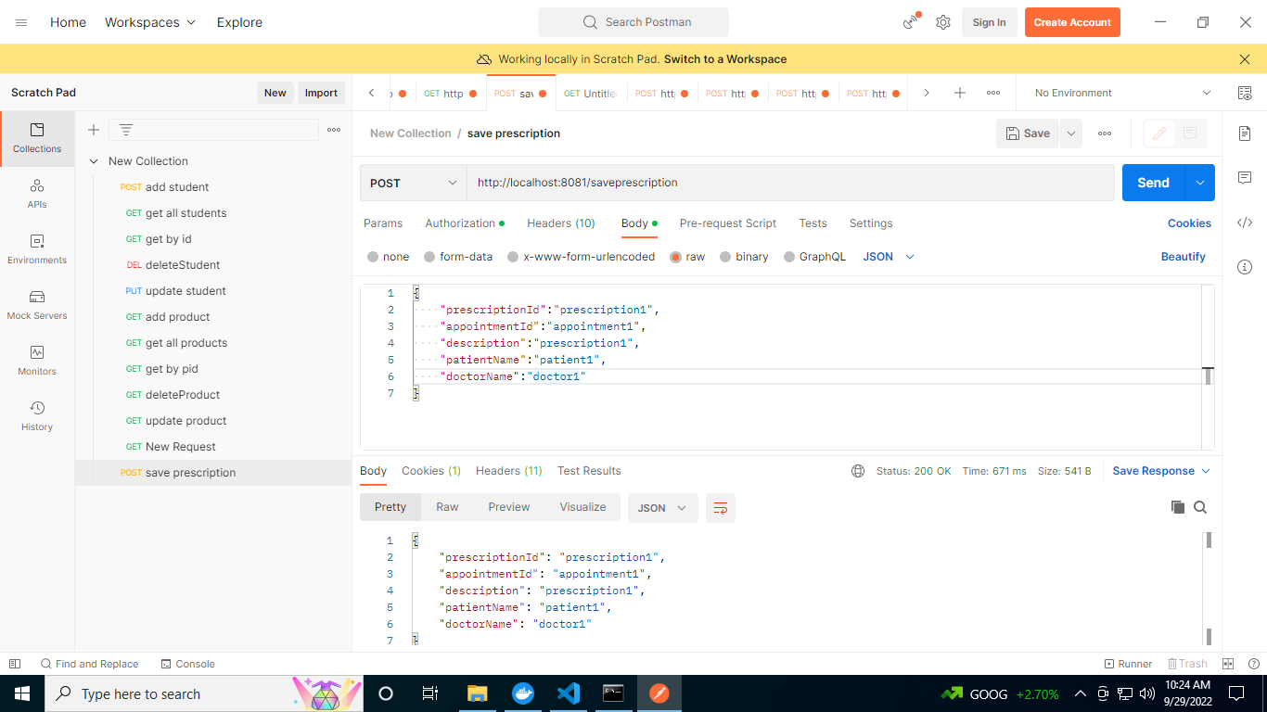
Postman POST request:

Slide 15
Postman GET request:

Slide 16
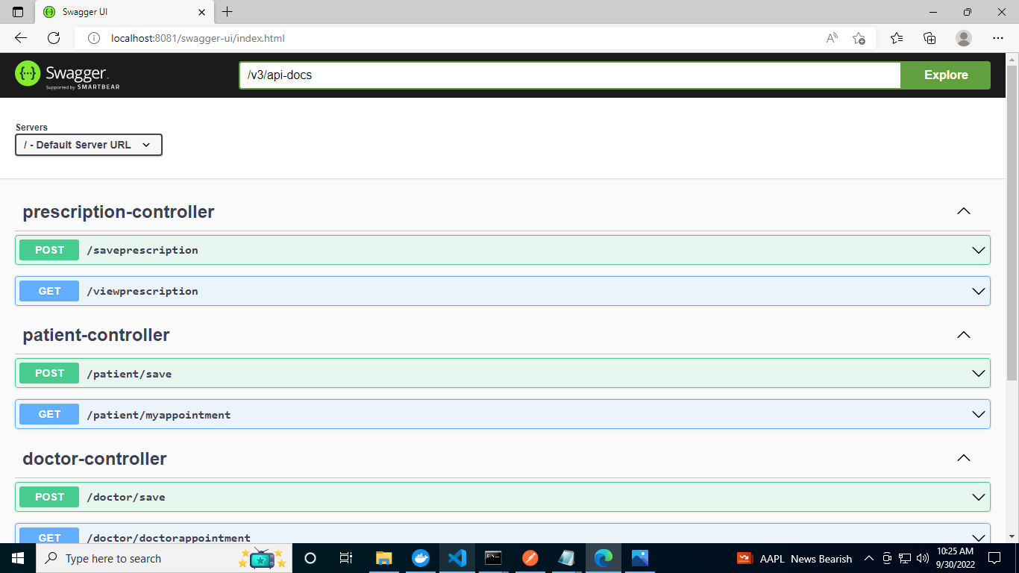
Swagger UI

Slide 17
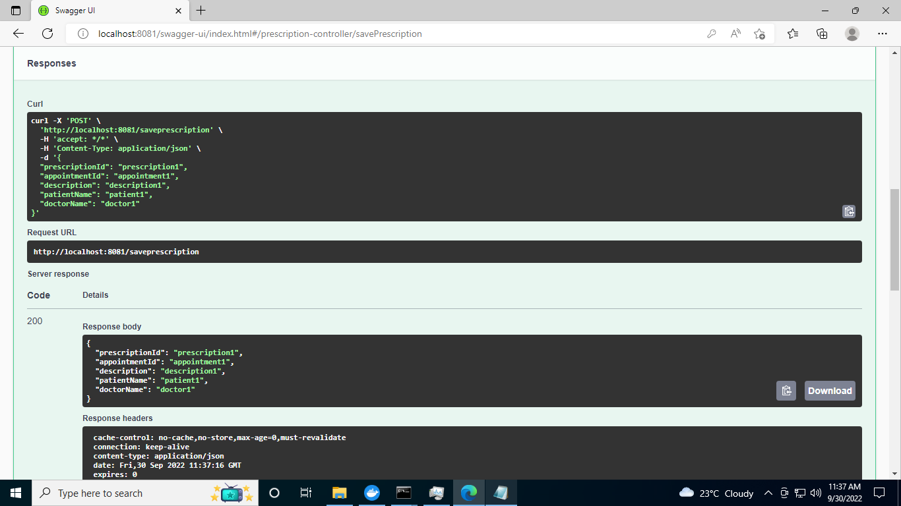
Swagger UI POST request:

Slide 18
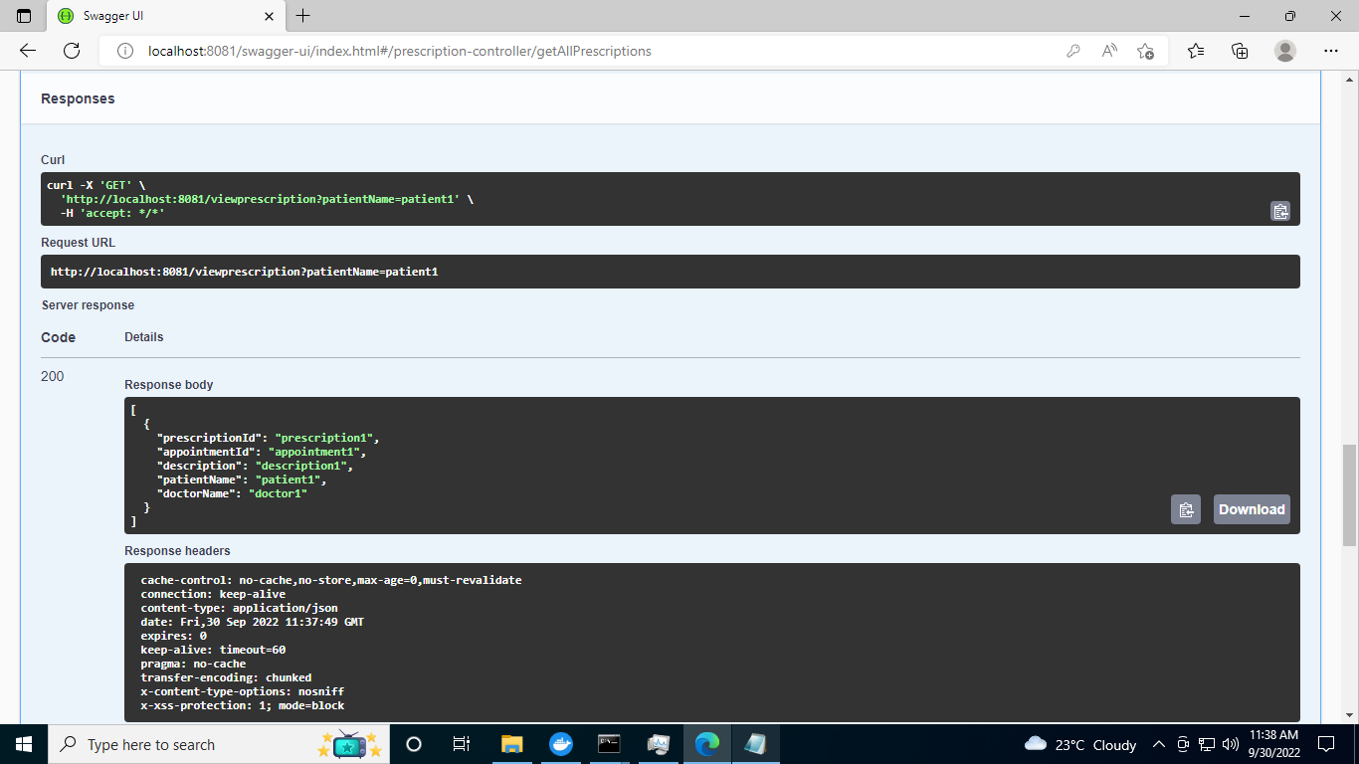
Swagger UI GET request:

Slide 19
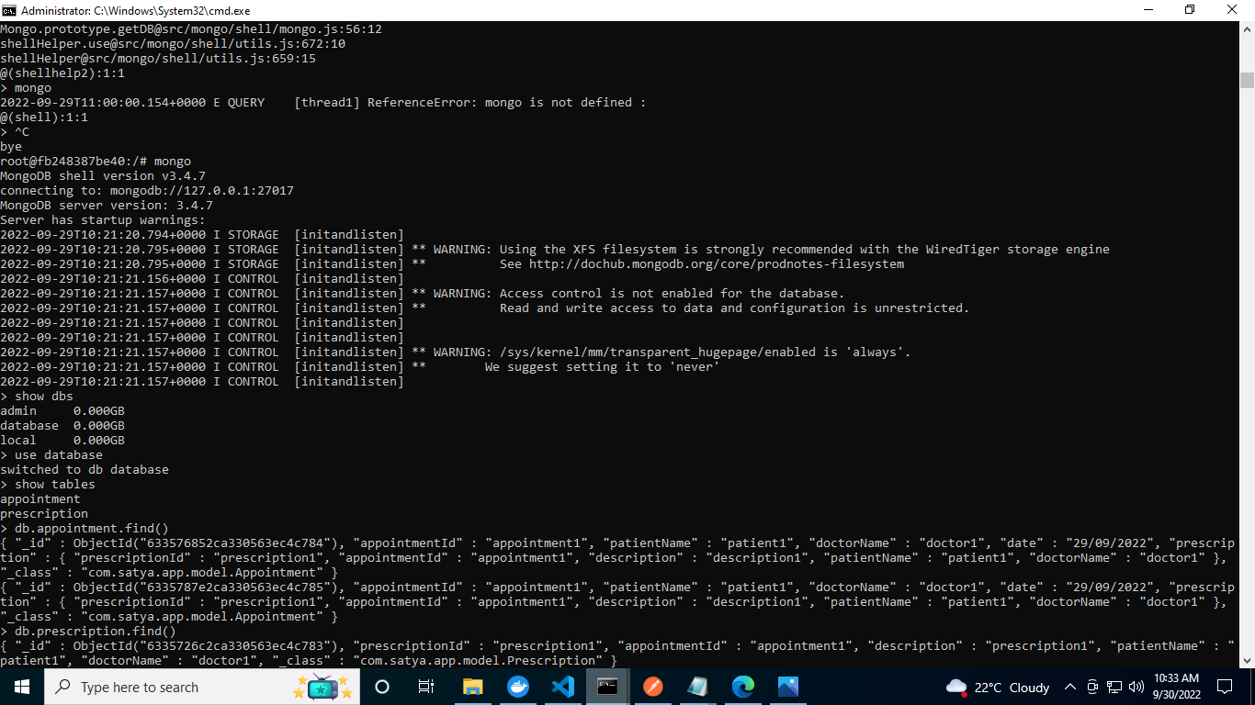
Mongodb bash:

Slide 20
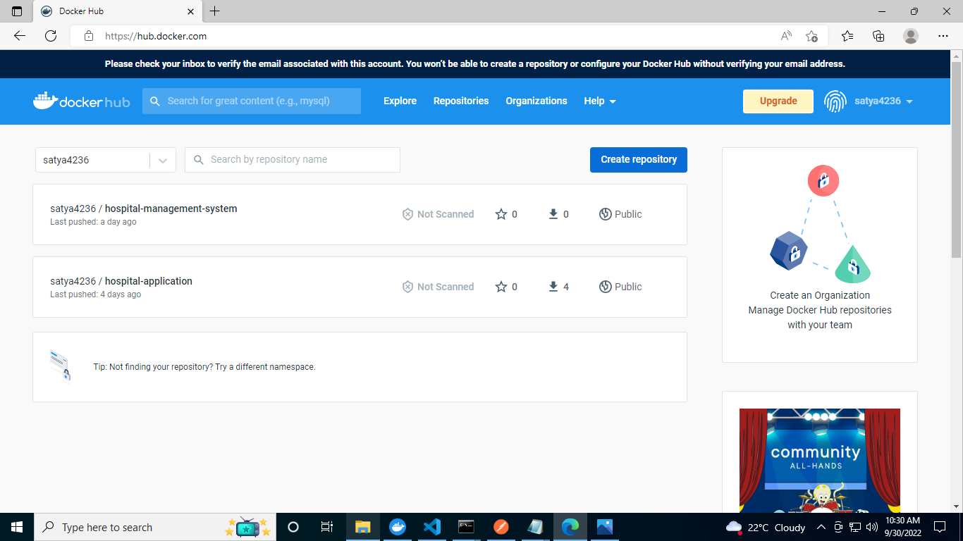
Docker hub repository:

Slide 21
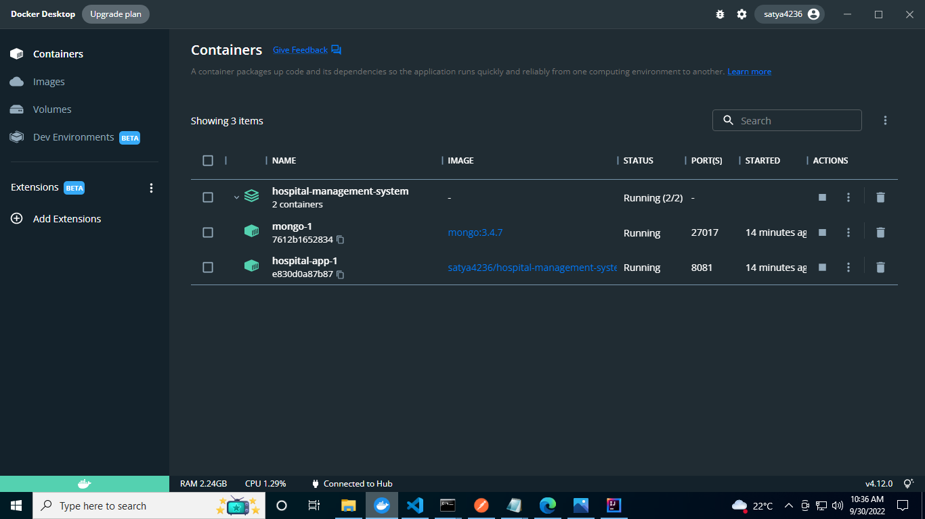
Docker Desktop running images in Container

Slide 22
Thank you

